Slide 1
ML Training Session - 5
Ada Boost and gradient boosting

Slide 2
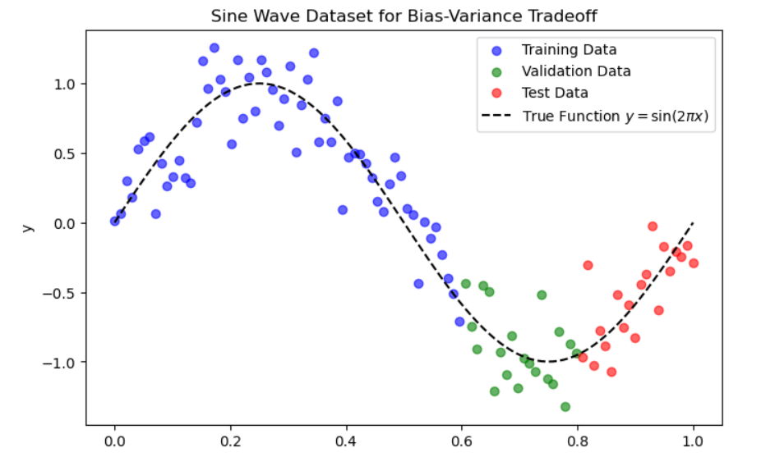
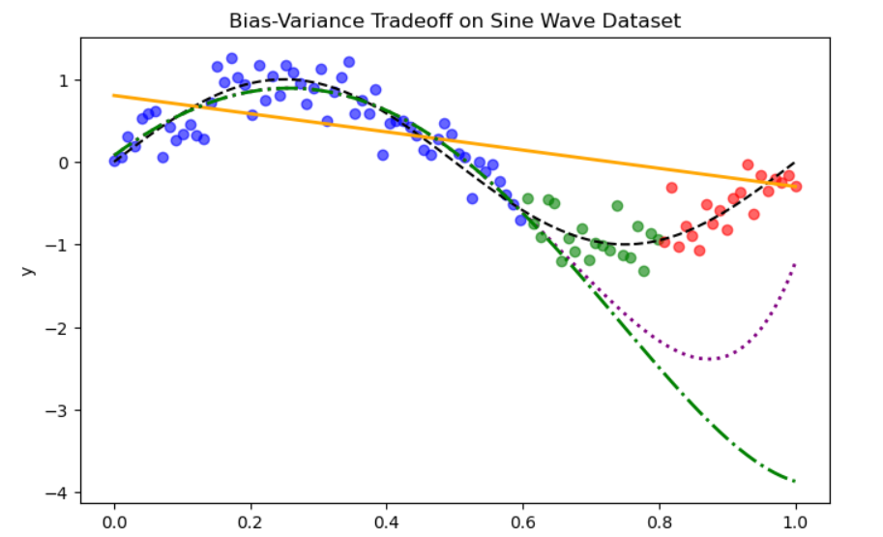
BIAS – VARIANCE TRADEOFF
Sine Wave with Train , Test and Validation

Slide 3
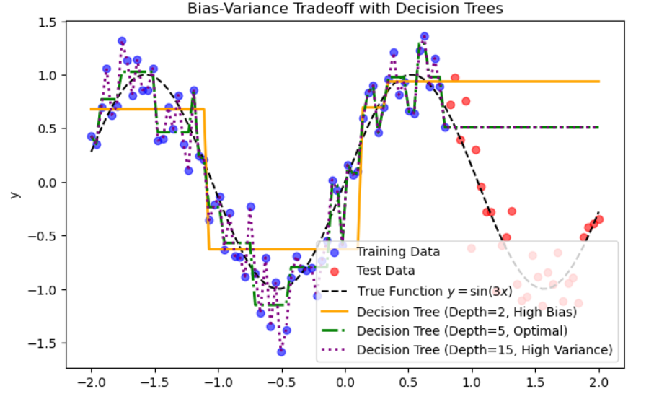
BIAS – VARIANCE TRADEOFF
Sine Wave with Train , Test and Validation

Slide 4
Inference
1. Bias Variance can be traded in every model, by choosing and optimizing the parameters
2. Every Model will have a different standing on Bias and Variance
Example: Linear Models will have High Bias and Low Variance , Tree Models will have High Variance Low Bias

Slide 5
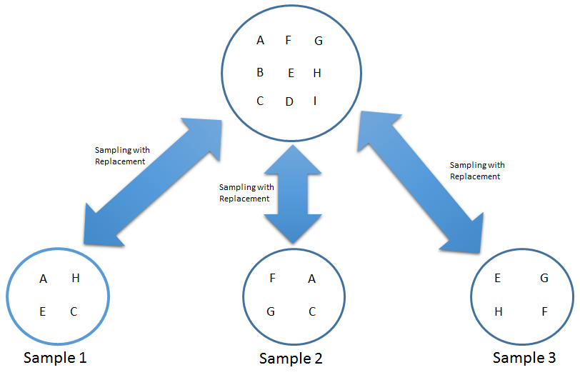
Bootstrapping
Random Sampling with replacement
Here in the example,
H is randomly sampled into sample 1 and 3

Slide 6
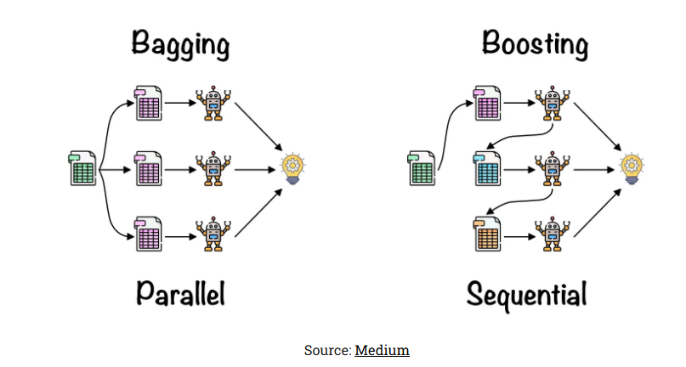
What is Boosting?
Bagging
Bagging involves training multiple independent models on different subsets of the dataset and then combining their predictions to produce a final output
Bagging helps in reducing Variance
Boosting
Boosting is to train models sequentially, where each new model tries to correct the errors made by the previous models
Boosting helps in reducing Bias
Source to read

Slide 7
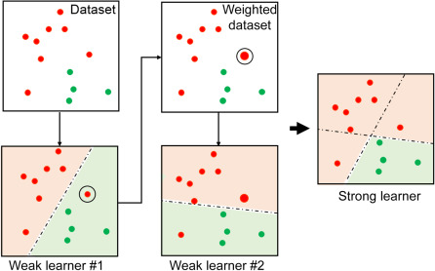
ADA Boost Algorithm
Algorithm was developed in 1996
Idea is to create multiple small weak learners ordered sequentially so that the final model is going to be a highly accurate

Slide 8
ADA Boost Algotrithm Interpretation
Stagewise Additive Modeling (SAMME)
Tries to give maximum weightage to the samples that have high residual errors in each iteration
Revise the sample weight for next tree
CHESTPAIN | BLOOD SUGAR | Hearrate >150 | Heart Disease | Sample weight
0 | 1 | 1 | 0 | 0.2
1 | 1 | 1 | 1 | 0.2
0 | 0 | 0 | 0 | 0.2
1 | 0 | 1 | 1 | 0.2
1 | 1 | 1 | 1 | 0.2
Residuals
Bsugar
Chest Pain
Hearrate
Residuals
1
0
1
0
1
0

Slide 9


ADA Boost Algorithm Interpretation
Total Error Sum of weights of misclassified records
Loss Functions
Performance Metrics
Classifier
Classifier uses GINI and Entropy. Normally GINI is used
Regressor
Regressor uses MSE, RMSE, MAE. Normally MSE is used
Performance of Stump (weightage of stump)
Classifier
Precision, Recall, F1 Score, ROC-AUC, ROC-PR
Regressor
MSE, RMSE, MAE
is total error
Calculate New weights

Slide 10
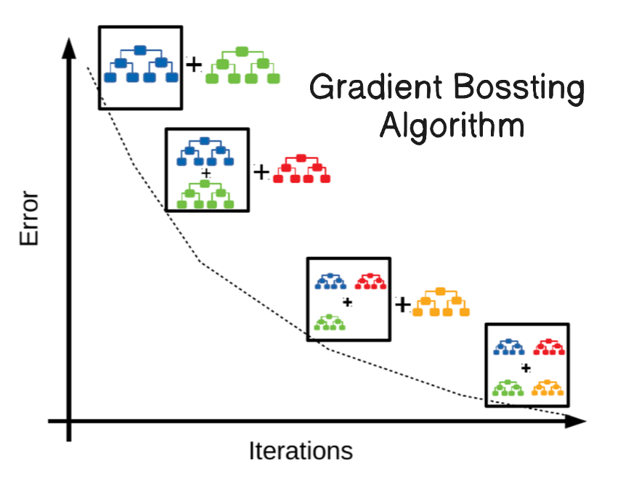
Gradient Boosting Algorithm
Algorithm is dependent on Gradient Descent Concept
It takes residuals of each iteration and optimizes a Dtree on the residuals by randomly sampling the records.
Each Dtree built based on Dtree algorithm , I.e., the splits and pruning happens based on Dtree algorithm

Slide 11
Gradient Boosting Algorithm Interpretation
Works on learning rate
CHESTPAIN | BLOOD SUGAR | Hearrate >150 | Heart Disease | Average Prediction
0 | 1 | 1 | 0 | 0.6
1 | 1 | 1 | 1 | 0.6
0 | 0 | 0 | 0 | 0.6
1 | 0 | 1 | 1 | 0.6
1 | 1 | 1 | 1 | 0.6
Hearrate
Chest Pain
Blood Sugar
1
0
1
0
1
0
Final Equation = Average prediction + λ * ChestPain Tree + λ * Blood Sugar Tree + λ * HeartRate Tree

Slide 12

Gradient Boosting Interpretation
Algorithm is same for both regressor and classifier
Only change is in classifier , the output of each tree is computed differently
To calculate output at leaf = Σresiduals in the leaf /Σ(p1*p0)
Now , once output is there, we take final output as Fm(x) = Model1 + Learning Rate * (Model2)
To convert the value into probability to find new residuals, we again transform it using sigmoid function

Slide 13
Code

